Slide 1
Voidrunner Echoes of darkness
Group Assignment 2

Slide 2
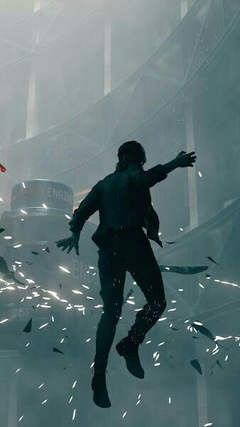
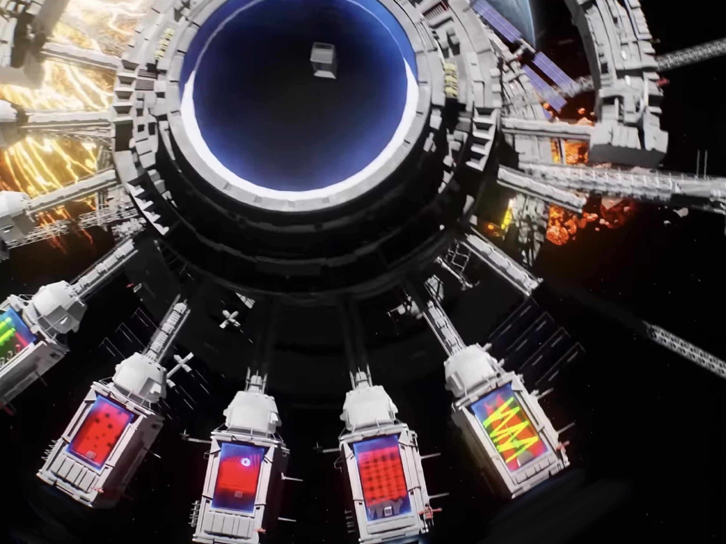
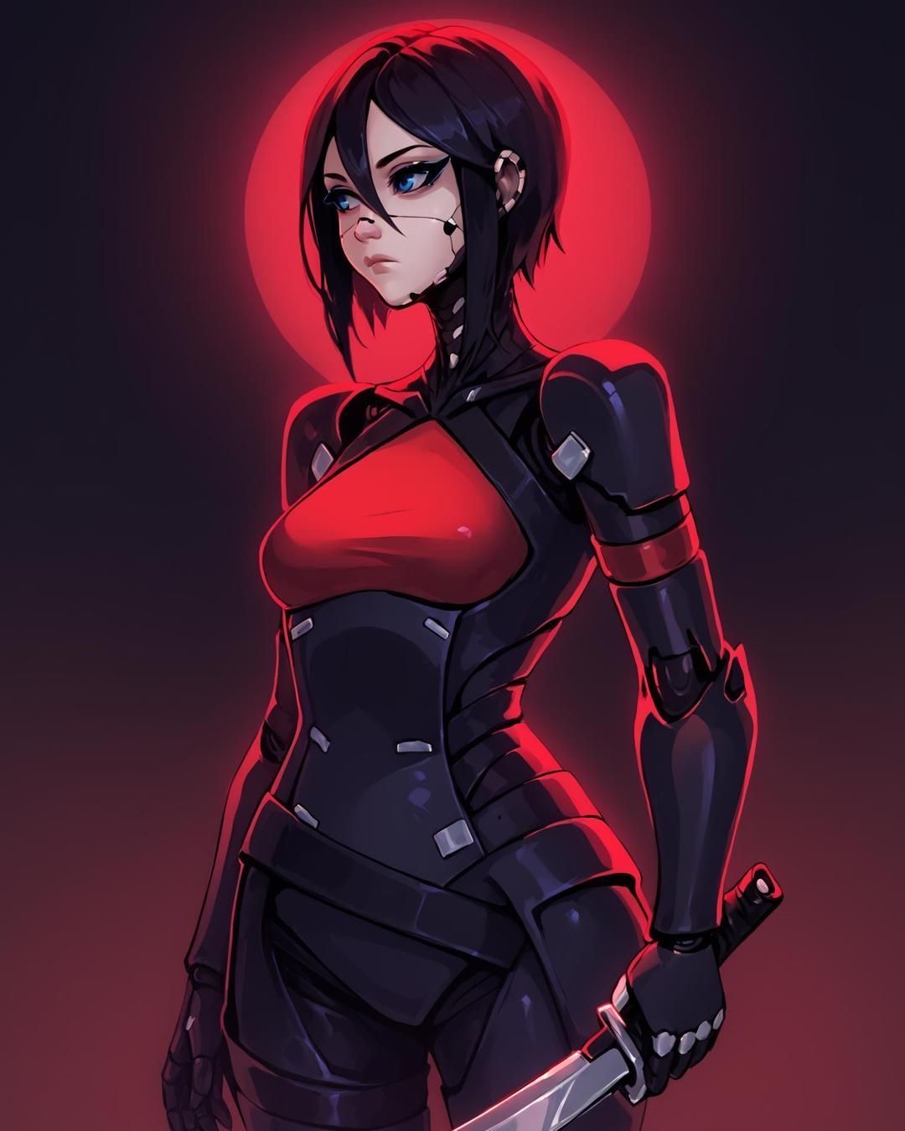
Overview
Genre
Setting
Characters
First-person Platformer
Sci-fi Spaceship
Cap 0 the cyborg, Black Crawlers,Void Crawlers.

Slide 3
Game overview
"Voidrunner: echoes of Darkness" is an intense first-person platformer set in the dark, in a floating spaceship.
Players take on the role of Cap 0, an elite cyborg to investigate and destroy the core of the ship. As Cap 0 explores the labyrinthine interior, discovers that the ship is infested with black, slimy creatures that can traverse walls and ceilings, making every surface a potential threat.

Slide 4
Story and exploration
Narrative: Destroy the ship's and escape from them.
Exploration: Non-linear exploration with multiple paths and secrets to discover. Some areas are only accessible with specific upgrades, encouraging replayability.
Atmosphere: The ship's environment is dark and foreboding, with flickering lights, ominous sounds, and eerie, organic growths that hint at the presence of the Void Crawlers.

Slide 5
Objective
Survive the horrors within the spaceship, uncover the Black Crawlers' presence, and find a way to eliminate the infestation and destroy the spaceship.
"Voidrunner: echoes of Darkness" aims to blend the thrill of first-person platforming with the tension of survival horror, offering players a unique and immersive experience in a sci-fi setting.

Slide 6
Game mechanics
01
02
03
Movement and platforming
Gravity manipulation
Environment unlocker
JetPack : Equipped with an advanced jet-pack, players can double jump, perform mid-air dashes, and wall-run to navigate the ship's intricate architecture.
Gravity Manipulation: Certain sections allow players to manipulate gravity, enabling them to walk on walls or ceilings, adding a layer of complexity to platforming challenges.
The spaceship is riddled with hazards like malfunctioning doors, electrical discharges, and broken pathways requiring precise timing and agility to overcome.

Slide 7
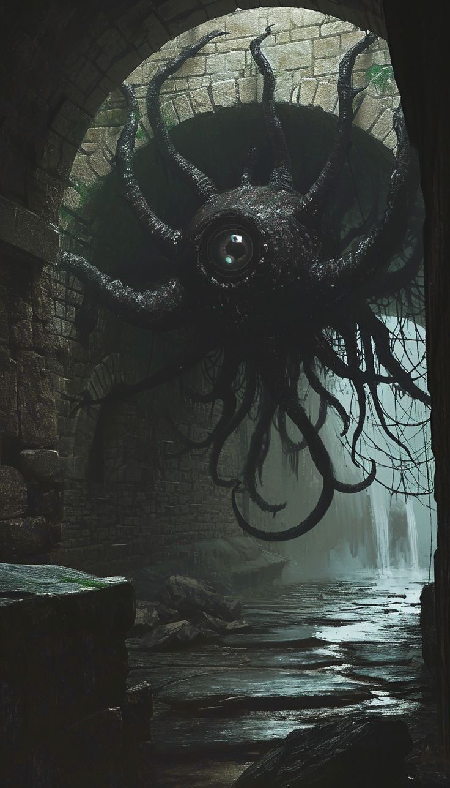
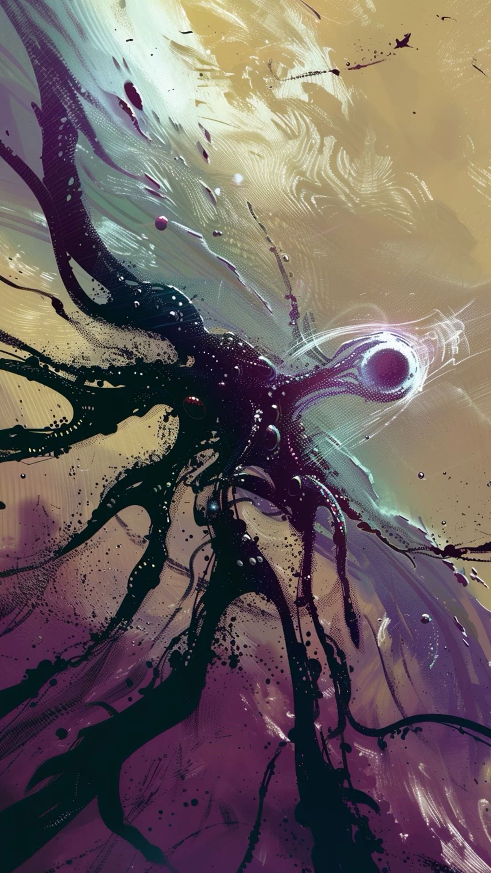
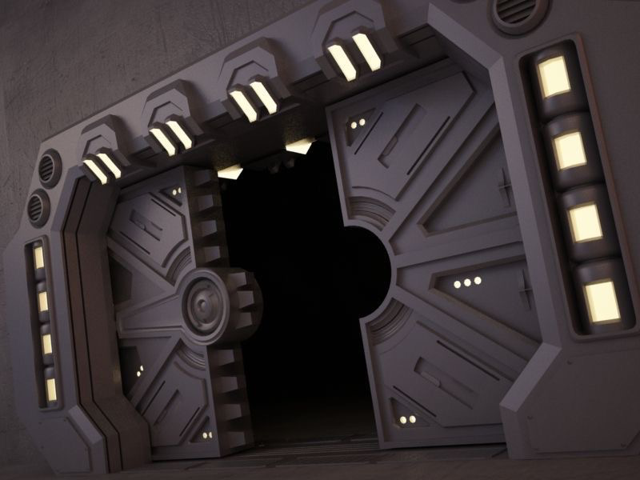
Enemies
Difficulty 30%
Difficulty 50%
Difficulty 70%
Black crawlers
These black, slimy creatures can cling to any surface. They are highly mobile and can ambush players from unexpected angles.
Environmental puzzles
Some areas require players to trigger traps or use environmental features to their advantage.
Void crawlers
Larger, more formidable enemies that control smaller Black Crawlers. Defeating them can temporarily pacify nearby creatures.

Slide 8
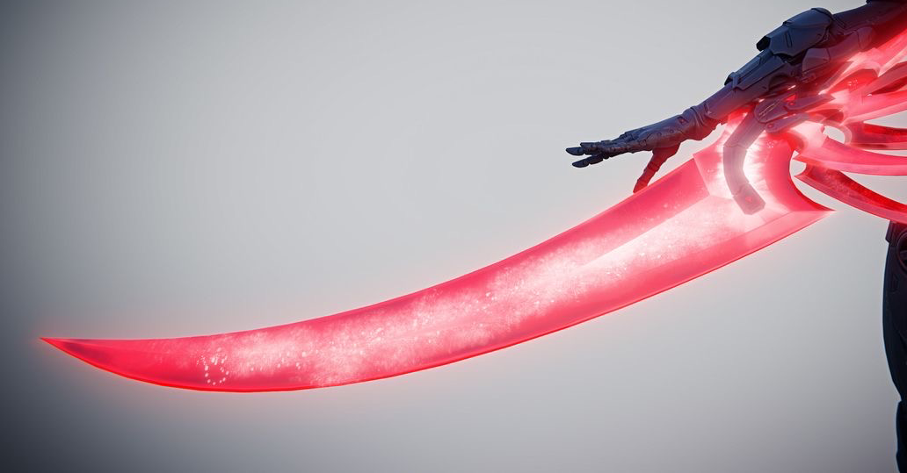
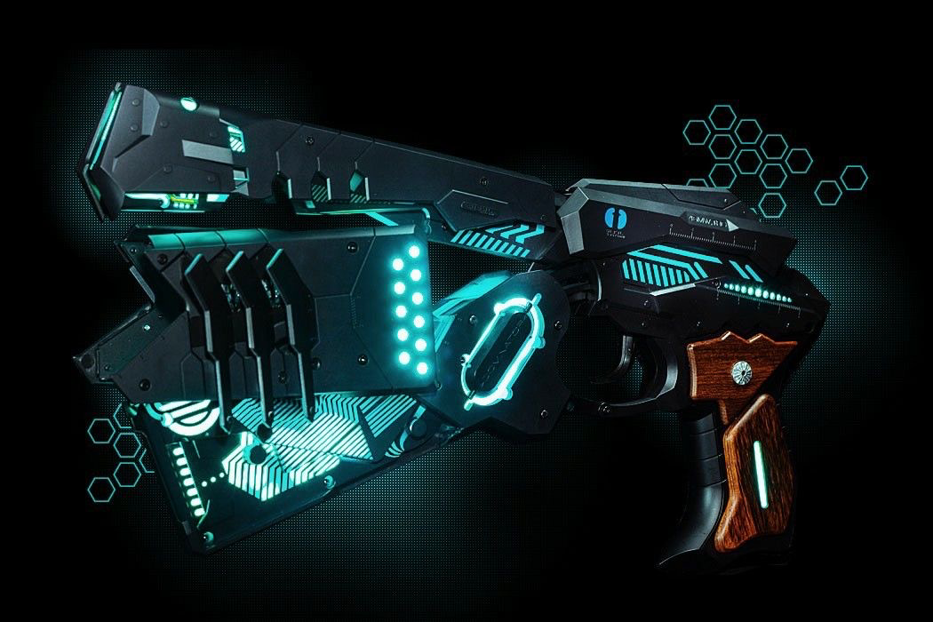
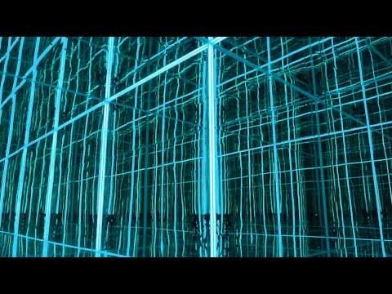
Tools and upgrades
 | Description
Plasma blade | A melee weapon for close-quarters combat, effective against the slimy creatures.
Blue blaster | A ranged weapon that can be upgraded with different modes (e.g., rapid fire, charged shots).
Scanner | A device to detect hidden puzzles in the environment

Slide 9
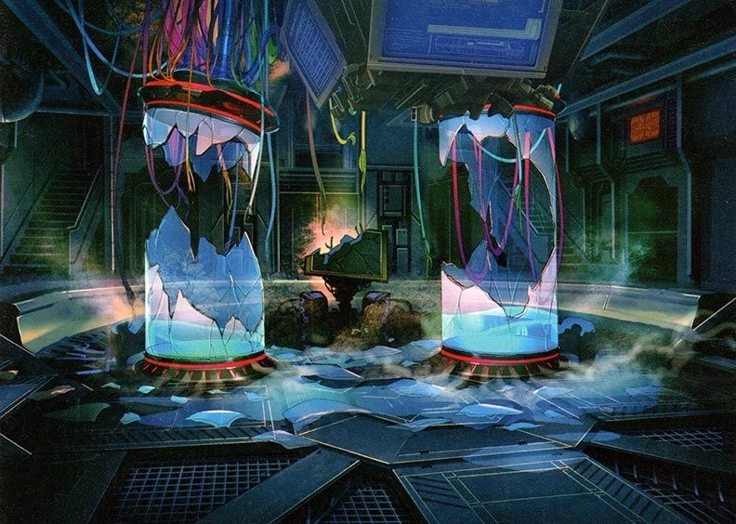
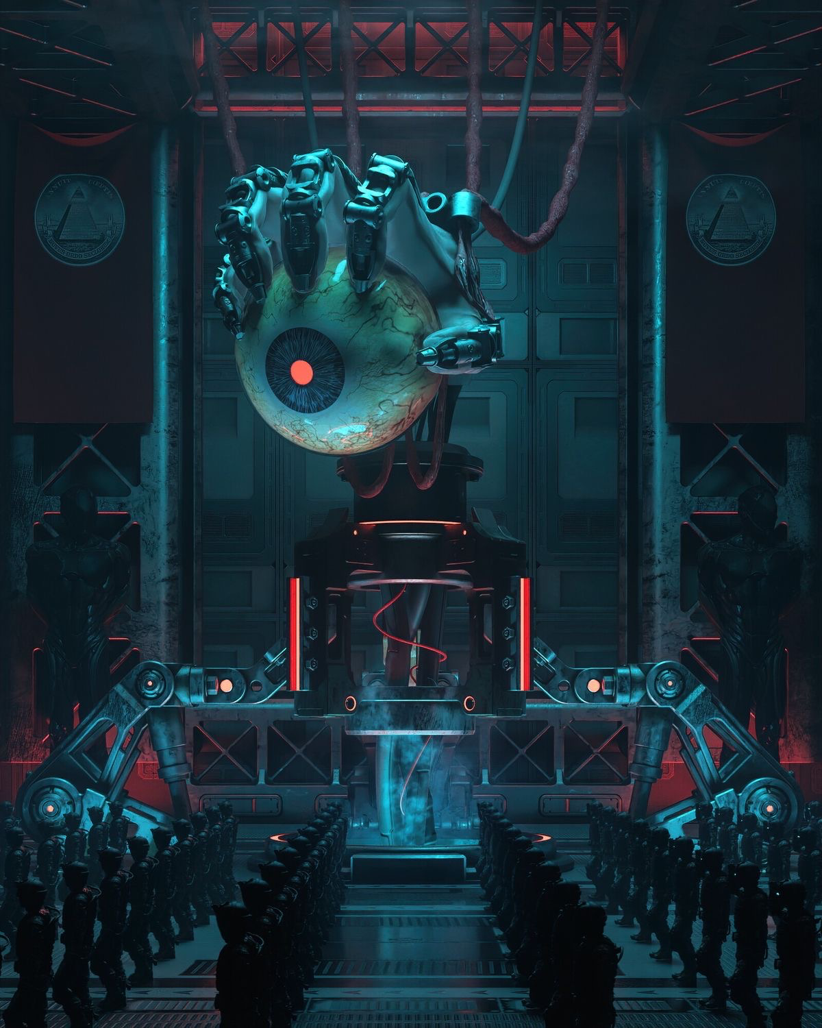
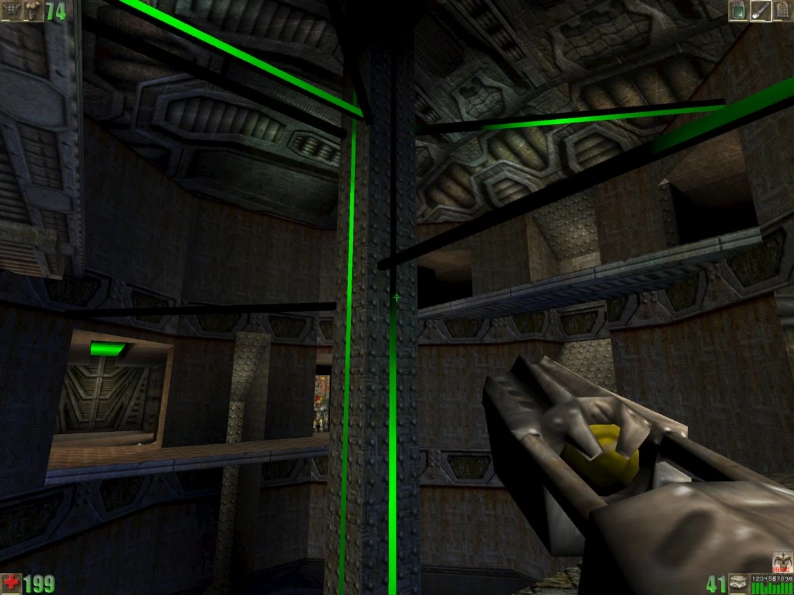
Visual style
Dark and futuristic
Dynamic lighting
Fogs and neon
The ship’s interior is a blend of sleek, futuristic design and decaying in some parts of the ship with organic corruption.
To add more of an ominous vibe to the setting and neon lights to give a sci-fi fee
Use of shadows and light to create tension and highlight the unpredictable nature of the enemies.

Slide 10
Sound design
Ambient sound
Music
The creaking of the ship, distant screeches, and the unsettling slithering of the creatures on walls.
A haunting, atmospheric soundtrack that intensifies during combat and critical platforming sequences.

Slide 11
Objective
Survive
Destroy
Survive the horrors within the spaceship, uncover the Black Crawlers' presence, and find a way to eliminate the infestation and destroy the spaceship.
Kill and discover the mastery behind the spaceship and destroy it.

Slide 12
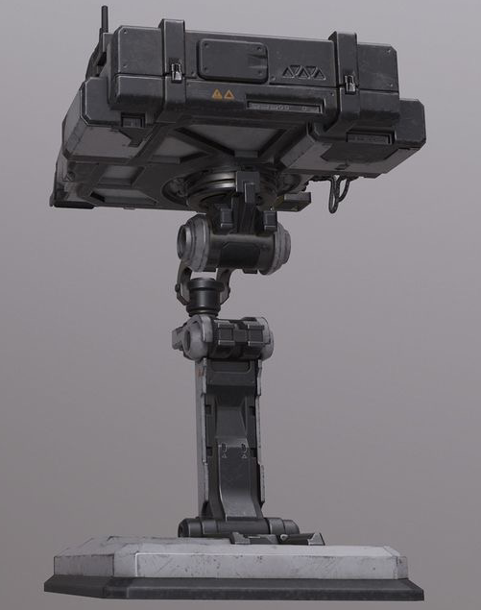
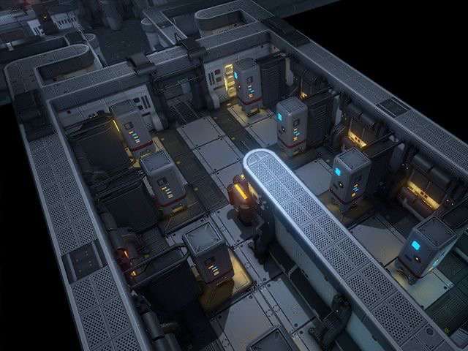
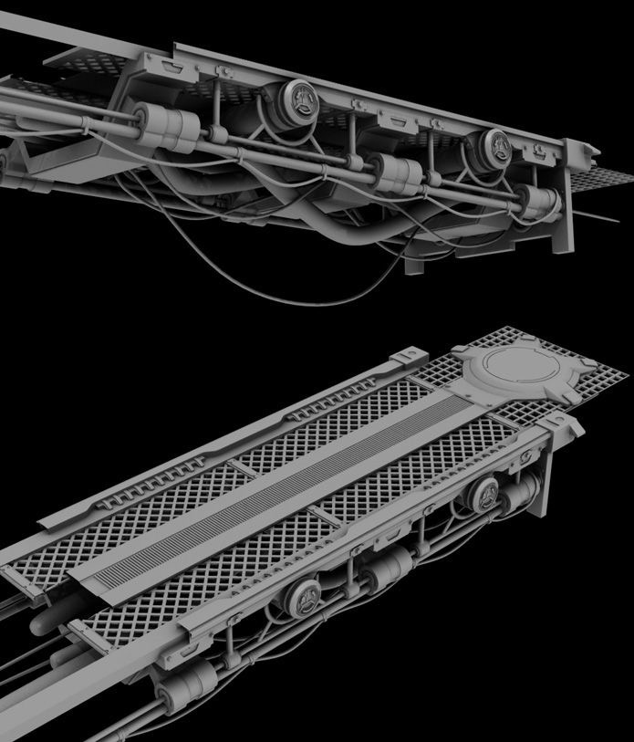
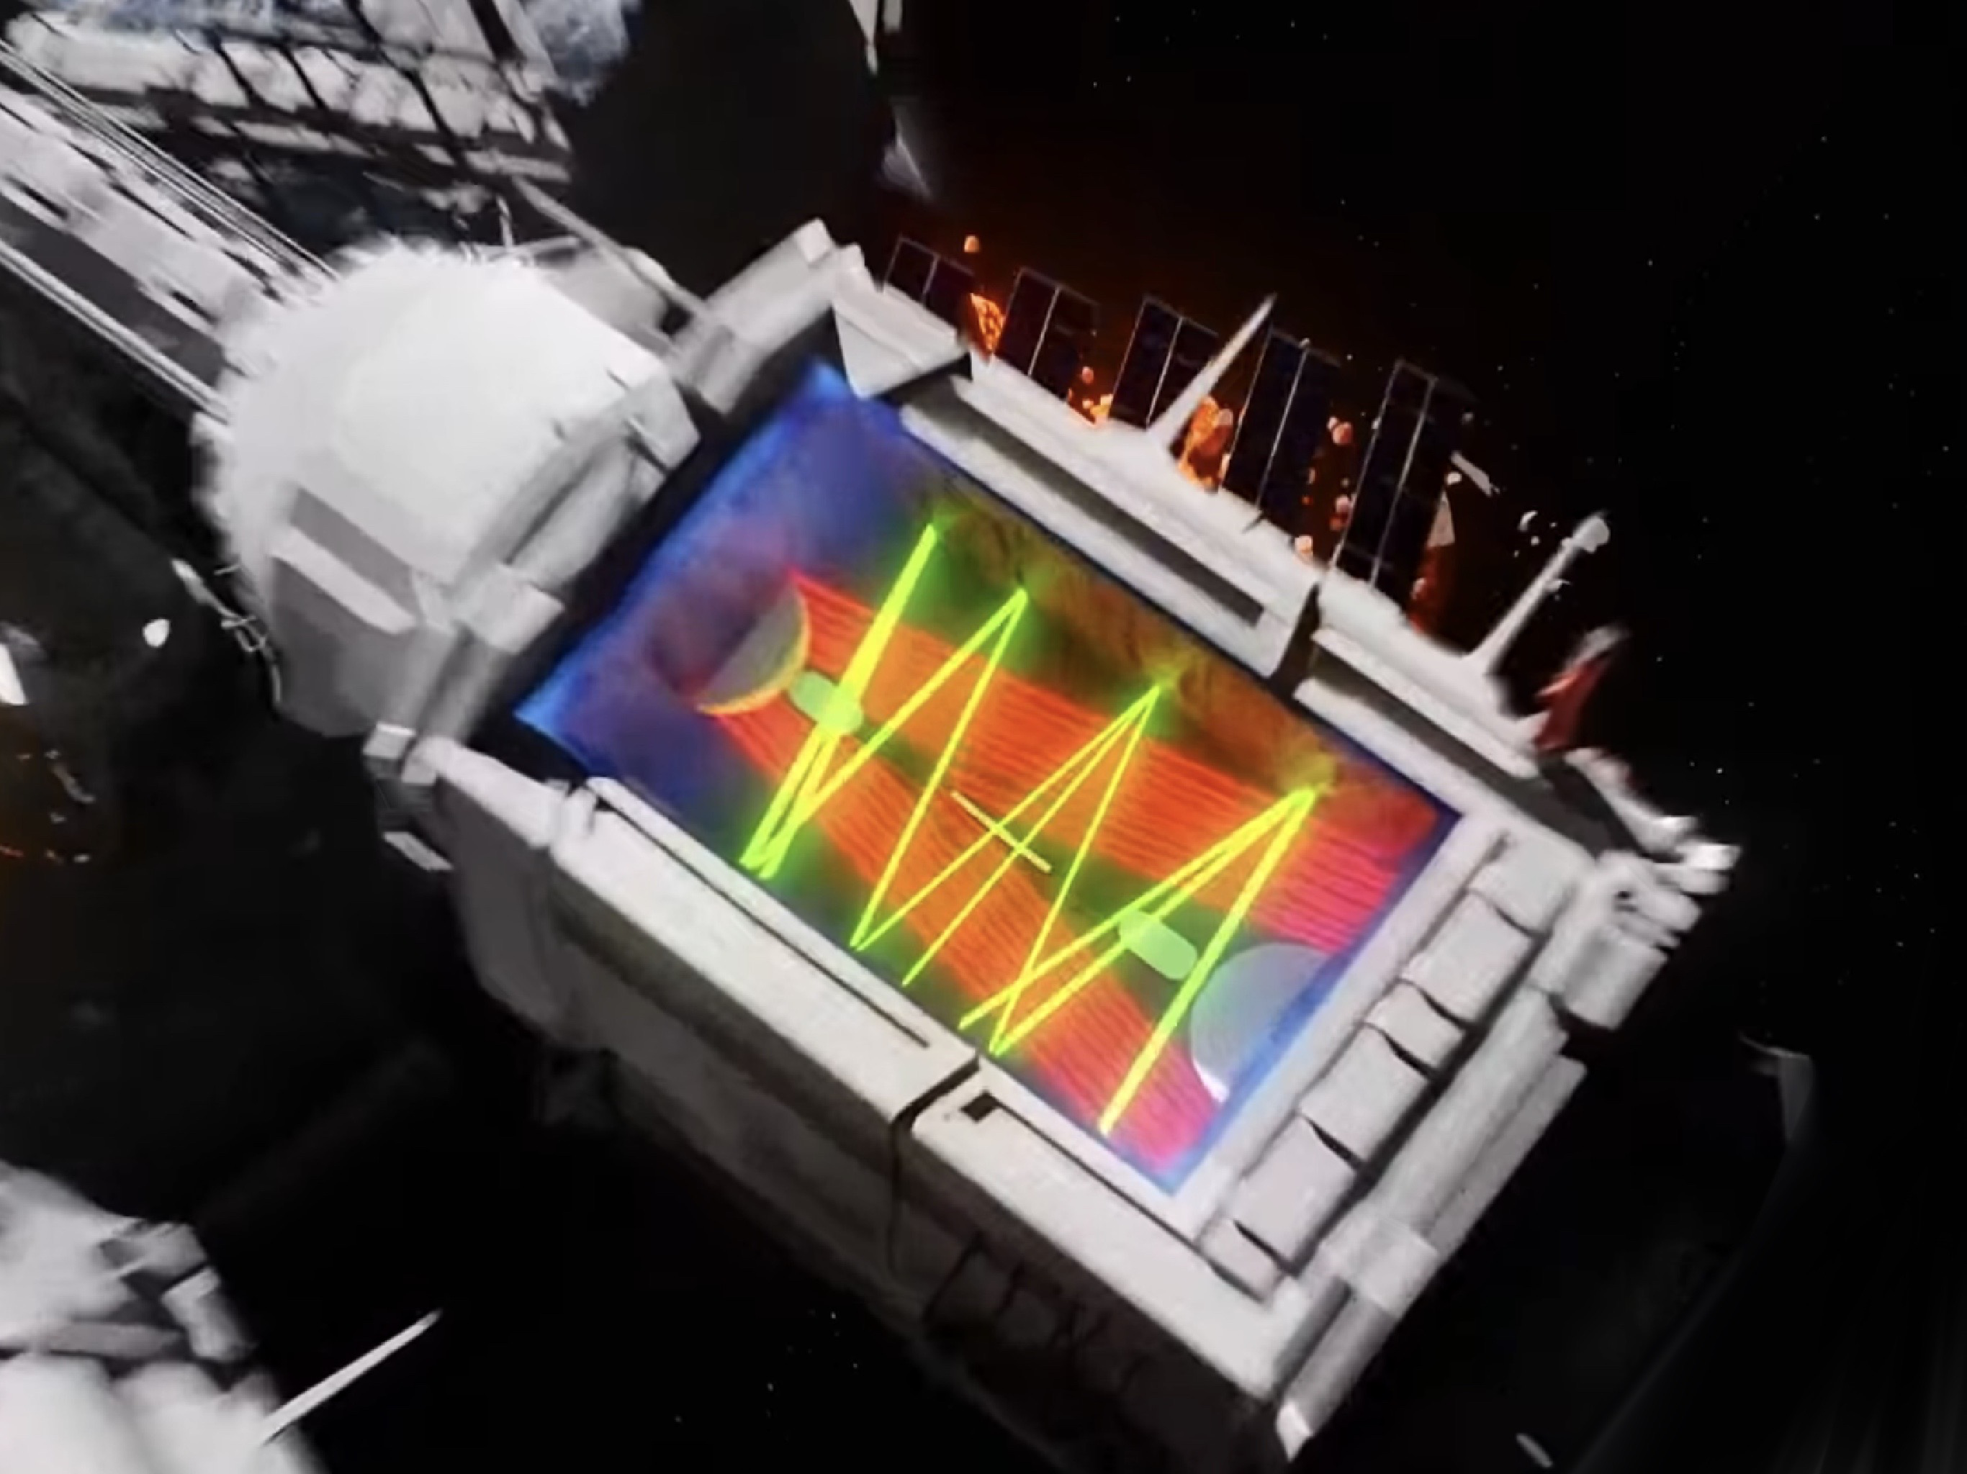
Obstacles
Moving platforms
Walls
The player has to to jump on moving platforms in different directions
The player have to jump over walls for go head
Pipes
Lasers
Jump and dodge the pipes
Avoid the laser long your way, exit from the laser maze

Slide 13
Sci-fi short film pitch deck
Mercury
75%
Mercury is the smallest planet in the Solar System
Earth
50%
Earth is the beautiful planet on which humans live
Mars
25%
Despite being red, Mars is actually a very cold place

Slide 14
Sci-fi short film pitch deck
01
Mercury
Mercury is the smallest planet in the Solar System
02
Earth
Earth is the beautiful planet on which humans live
03
Mars
Despite being red, Mars is actually a very cold place
04
Jupiter
Jupiter is the biggest planet in the Solar System

Slide 15
Sci-fi short film pitch deck
 | Mon | Tue | Wed | Thu | Fri
Saturn | Saturn is a gas giant | Neptune is an ice giant | Venus is a hot planet | Mercury is a small planet | Mars is a cold planet
Jupiter | Mercury is very small | Saturn is a gas giant | Mars is made of basalt | Jupiter is a big planet | Earth has lots of life
Mars | Venus is a hot planet | Earth has lots of life | Mars is a cold planet | Mercury is very small | Neptune is an ice giant

Slide 16
Sci-fi short film pitch deck
Task list
Mercury is the smallest planet in the Solar System | Jan - 03 | Done!
Earth is the beautiful planet on which humans live | Jan - 12 | To do
Despite being red, Mars is actually a very cold place | Feb - 05 | To do
Jupiter is the biggest planet in the Solar System | Mar - 21 | Done!

Slide 17
Sci-fi short film pitch deck
Jupiter
Jupiter is a gas giant and the biggest planet in the Solar System. It's the fourth-brightest object in the night sky. It was named after the Roman god of the skies and lightning
Mercury
50%
Saturn
75%
Mercury is the smallest planet in the Solar System
Saturn is composed mostly of hydrogen and helium

Slide 18
Sci-fi short film pitch deck
Mon | Tue | Wed | Thu | Fri | Sat | Sun
 |  |  |  | 1 | 2 | 3
4 | 5 | 6 | 7 | 8 | 9 | 10
11 | 12 | 13 | 14 | 15 | 16 | 17
18 | 19 | 20 | 21 | 22 | 23 | 24
25 | 26 | 27 | 28 | 29 | 30 | 31
Neptune is far away from the Sun
Mars is a very cold planet

Slide 19
Sci-fi short film pitch deck
75%
25%
Saturn
Neptune
Saturn is a gas giant and has several rings
Neptune is the farthest planet from the Sun

Slide 20
Sci-fi short film pitch deck
Ceres
Pluto
Jupiter is the biggest planet of them all
Saturn is a gas giant and has rings
Earth is the third planet from the Sun
Venus is the second planet from the Sun
Neptune is very far away from the Sun
Jupiter doesn’t have a solid surface

Slide 21
Sci-fi short film pitch deck
01
02
03
04
Jupiter
Earth
Venus
Saturn
Jupiter is the biggest planet of them all
Earth is the third planet from the Sun
Venus is the second planet from the Sun
Saturn is a gas giant and has several rings

Slide 22
Sci-fi short film pitch deck
Jupiter
Earth
Mercury
Jupiter is a huge gas giant
Earth is the planet with life
Mercury is a small planet

Slide 23
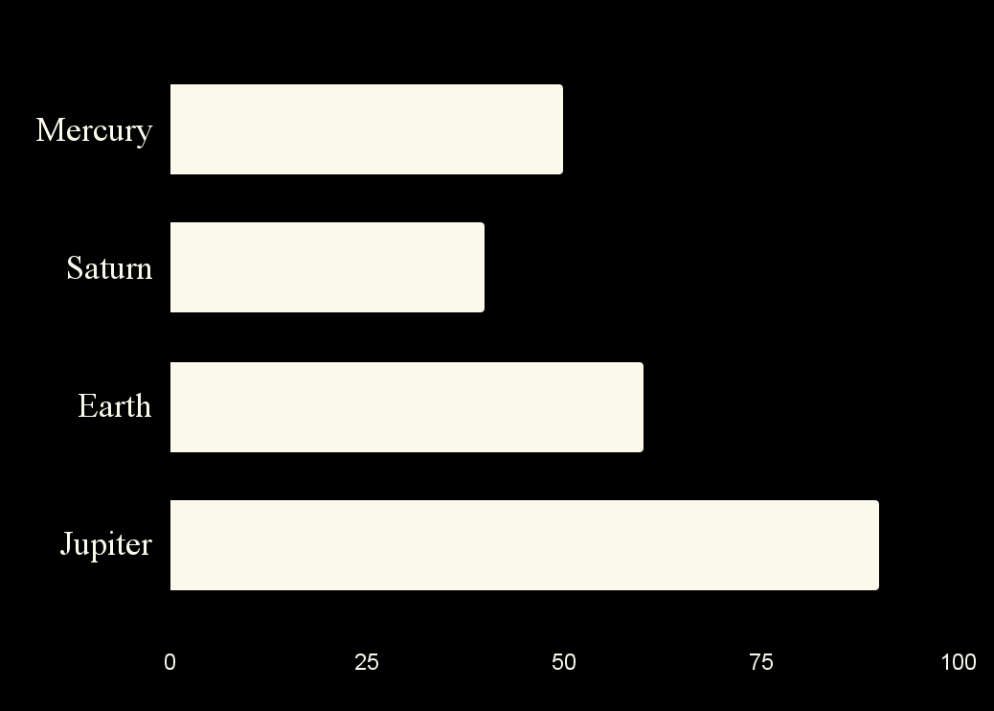
Sci-fi short film pitch deck
Mercury - 50%
Saturn - 40%
Mercury is a small planet
Saturn has several rings
Earth - 60%
Jupiter - 90%
Earth is the planet with life
Jupiter is a huge gas giant
Follow the link in the graph to modify its data and then paste the new one here. For more info, click here

Slide 24
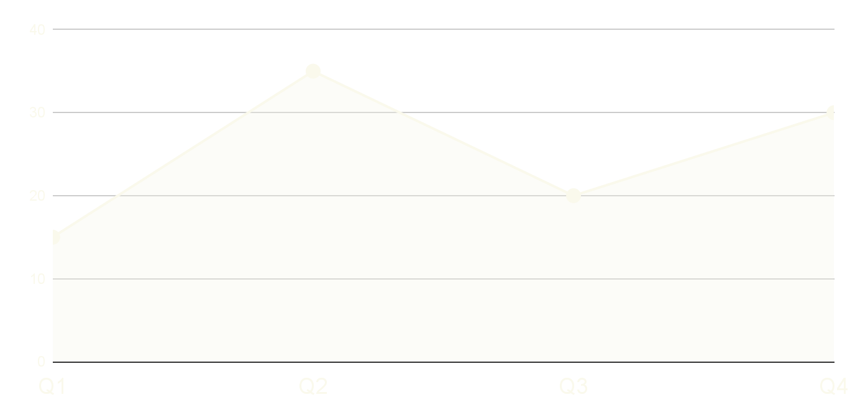
Sci-fi short film pitch deck
Q1 | $15,000
Q2 | $35,000
Q3 | $20,000
Q4 | $30,000
Follow the link in the graph to modify its data and then paste the new one here. For more info, click here

Slide 25
Sci-fi short film pitch deck
01 | CAST & CREW | 4 months | $40,000
02 | EQUIPMENT | 7 months | $10,000
03 | ART DEPT. | 2 months | $5,000
04 | INSURANCE | 1 year | $15,000
05 | CATERING | 9 months | $5,000
06 | LOCATIONS | 4 months | $25,000

Slide 26
Sci-fi short film pitch deck
2XXX
2XXX
2XXX
Jupiter
2XXX
Earth
Jupiter is a huge gas giant
Mars
Earth is the planet with life
Mercury
Mars is a very cold place
Mercury is a small planet

Slide 27
Sci-fi short film pitch deck
Jan | Feb | Mar | Apr | May | Jun
 |  |  |  |  |  | Jupiter
 |  |  |  |  |  | Mars
 |  |  |  |  |  | Venus
 |  |  |  |  |  | Earth
 |  |  |  |  |  | Saturn

Slide 28
Sci-fi short film pitch deck
Earth
Earth is the planet with life
Neptune
Jupiter
Jupiter is a huge gas giant
Saturn
Mars
Mars is a very cold place
Venus
Mercury
Mercury is a small planet

Slide 29
Sci-fi short film pitch deck
01
Saturn is composed mostly of hydrogen and helium
02
Mercury is the smallest planet in the Solar System
03
Despite being red, Mars is actually a very cold place
04
Earth is the beautiful planet on which humans live

Slide 30
Sci-fi short film pitch deck
20%
35%
50%
75%
Mercury
Mars
Earth
Jupiter
Mercury is a small planet
Mars is a very cold place
Earth is the planet with life
Jupiter is a huge gas giant

Slide 31
Sci-fi short film pitch deck
20%
Earth
Earth is the planet with life
40%
Mars
Mars is a very cold place
30%
Mercury
Mercury is a small planet
10%
Jupiter
Jupiter is a huge gas giant

Slide 32
Sci-fi short film pitch deck
Venus
Jupiter
Venus is the second planet from the Sun
Jupiter is a gas giant and the biggest planet of them all
Saturn
Neptune
Saturn is composed mostly of hydrogen and helium
Neptune is the farthest planet from the Sun
Earth
Mars
Earth is the third planet from the Sun and has life
Despite being red, Mars is actually a cold place

Slide 33
Sci-fi short film pitch deck
Venus
Jupiter
Venus is the second planet from the Sun
Jupiter is the biggest planet of them all
Earth
Mars
Earth is also known as the Blue Planet
Despite being red, Mars is very cold
Saturn
Neptune
Saturn is a gas giant and has several rings
Neptune is the farthest planet from the Sun

Slide 34
Sci-fi short film pitch deck
Venus
Venus is the second planet from the Sun
Saturn
Neptune
Saturn is a gas giant and has several rings
Neptune is the farthest planet from the Sun
Jupiter
Jupiter is the biggest planet of them all

